Slide 1

P peline
The Data
Information Visualization
© Jennifer Mankoff
The Data Pipeline; HCII; Spring 2014
Slides cribbed from Marti Hearst http://courses.ischool.berkeley.edu/i247/f05/ (slides 2-10, 16, 19-21, 23, 25-37); Jian Huang, based on a tutorial by Daniel Kiem (slides 39-58); Beomjin Kin (11-14, 17-18)

Slide 2
Byte 2 Results
Expectations about the data:
When dogs are abandoned: Some of you expected that dogs would be abandoned young (before bonding)
Outcomes: Some were surprised by the number of dogs euthanized.
Animal arrivals are fairly uniformly distributed as one might expect. However there is a slight trend of more animals arriving in the shelter in summer than winter months. Thoughts on why?
Many of the animals have names. Why? (I suspect the shelter is giving the animals names to help them be adopted)
Many young dogs are euthanized. Why? Reasons are missing from the data, and breed is hard to compare because of issues mentioned below.
Expected outcomes to be similar for cats and dogs, but cats are much more likely to be euthanized.

Slide 3
Byte 2 Results
Ages are not numerical -- because they are estimates. Some questions about why these groupings (I would argue it has to do with expected adoptability). Also, it was pointed out that age could be ambiguous as it is described (though I would argue the shelter staff know how to interpret it).
Outcome dates are greater than Intake dates
Zip code found has a 99% overlap with the Louisville area
There is no particular relationship between zip found and zip placed (domain knowledge says this makes sense to me)
Some animalIDs are repeated. Based on other properties of these rows it seems that some animals that leave and return multiple times?

Slide 4
Byte 2 Results
Errors and Problems in the data:
37% of the age data is missing !
Spatial data is missing many values (over 2000 in the case of longitude)
Some zip codes are missing (esp. for zip found); some are invalid possibly due to typographical errors.
Outcome subtype, which can help us understand what goes on in the shelter, is missing in over 2000 rows.
Some euthanized animals also have a zip placed value
Some columns are redundant (could introduce errors)
There are over 500 distinct breeds, some of which are redundant; and 75% of records have no value (across cats and dogs?)
Some visualizations to explore that highlight a few of these points:
http://jianf-byte2.appspot.com
http://amarella-byte2.appspot.com

Slide 5
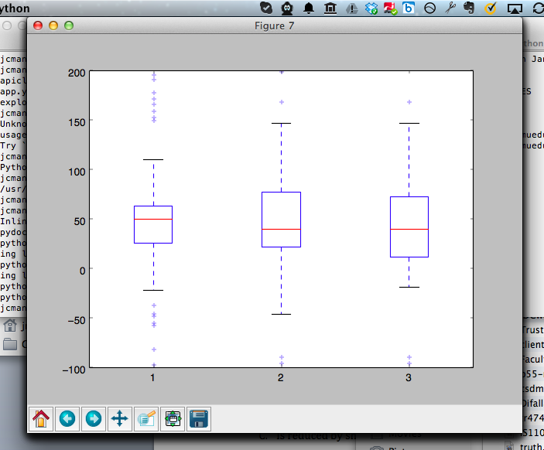
Boxplot [Random Data; 3 times]
Notes:
I made a mistake – the boxes are quartiles (25% of all data); the lines are ‘extremes’ (75% of all observations)

Slide 6
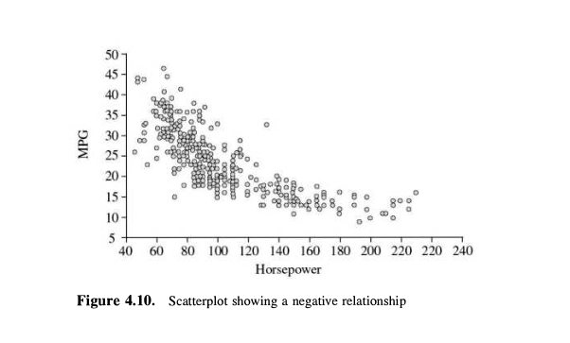
Scatterplot
Notes:
We also didn’t talk about one other very common kind of plot which lets you eyeball correlation – scatter plots

Slide 7
What is Information Visualization?
Visualize: to form a mental image or vision of …
Visualize: to imagine or remember as if actually seeing.
American Heritage dictionary, Concise Oxford dictionary

Slide 8
What is Information Visualization?
The depiction of information using spatial or graphical representations, to facilitate comparison, pattern recognition, change detection, and other cognitive skills by making use of the visual system (Hearst 03).
“that which gives to the viewer the greatest number of ideas in the shortest time with the least ink in the smallest space.” --Edward R. Tufte
Further Reading: http://fellinlovewithdata.com/guides/7-classic-foundational-vis-papers
Notes:
To help:
Explore
Calculate
Communicate
Decorate

Slide 9
Visualization Success Story
Mystery: what is causing a cholera epidemic in London in 1854?

Slide 10
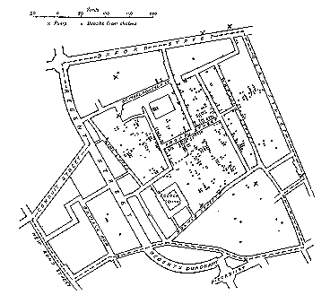
Visualization Success Story
Illustration of John Snow’s
deduction that a cholera epidemic
was caused by a bad water pump, circa 1854.
Horizontal lines indicate location of deaths.
From Visual Explanations by Edward Tufte, Graphics Press, 1997

Slide 11
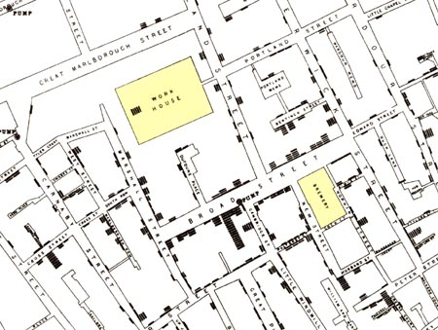
Visualization Success Story
Illustration of John Snow’s
deduction that a cholera epidemic
was caused by a bad water pump, circa 1854.
Horizontal lines indicate location of deaths.
From Visual Explanations by Edward Tufte, Graphics Press, 1997

Slide 12
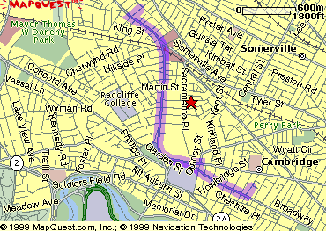
The Power of Visualization
1. Start out going Southwest on ELLSWORTH AVE
Towards BROADWAY by turning right.
2: Turn RIGHT onto BROADWAY.
3. Turn RIGHT onto QUINCY ST.
4. Turn LEFT onto CAMBRIDGE ST.
5. Turn SLIGHT RIGHT onto MASSACHUSETTS AVE.
6. Turn RIGHT onto RUSSELL ST.

Slide 13
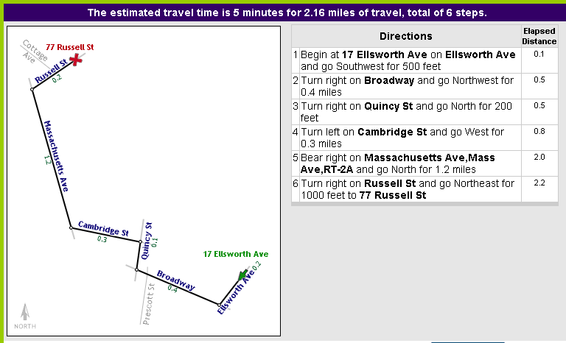
The Power of Visualization
Line drawing tool by Maneesh Agrawala http://graphics.stanford.edu/~maneesh/

Slide 14
Two Different Primary Goals: Two Different Types of Viz
Explore/Calculate
Analyze
Reason about Information
Communicate
Explain
Make Decisions
Reason about Information

Slide 15
Communication should:
Make large datasets coherent
Compact
Multivariate
Present information from various viewpoints
Support visual comparisons [Tufte]
Tell stories about the data (causality & structure...)
Have visual integration (images, words, etc.)
Document for credibility (baseline, scale, context)
Notes:
But remember “analytical presentations ultimately stand or fail depending on the quality, relevance, and integrity of their content” [Tufte, Beautiful Evidence, p. 136]

Slide 16
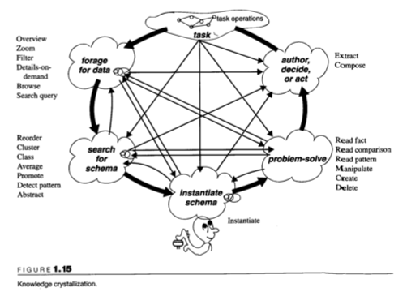
Supporting the Viewer
Overview
Zoom
Filter
Details-on-demand
Browse
Search query
Extract
Compose
Read fact
Read comparison
Read pattern
Manipulate
Create
Delete
Reorder
Cluster
Class
Average
Promote
Detect pattern
Abstract
Instantiate
Readings in Information Visualization: Using Vision to Think
edited by Stuart K. Card, Jock D. Mackinlay, Ben Shneiderman
Notes:
Different ways that visualizations could help amplify cognition: 1. By increasing memory and processing resources available 2. By reducing the amount of time to search 3. Enhancing the detections of patterns and enabling perceptual inference operations 4. Aid perceptual monitoring 5. By encoding information in a manipulable medium

Slide 17
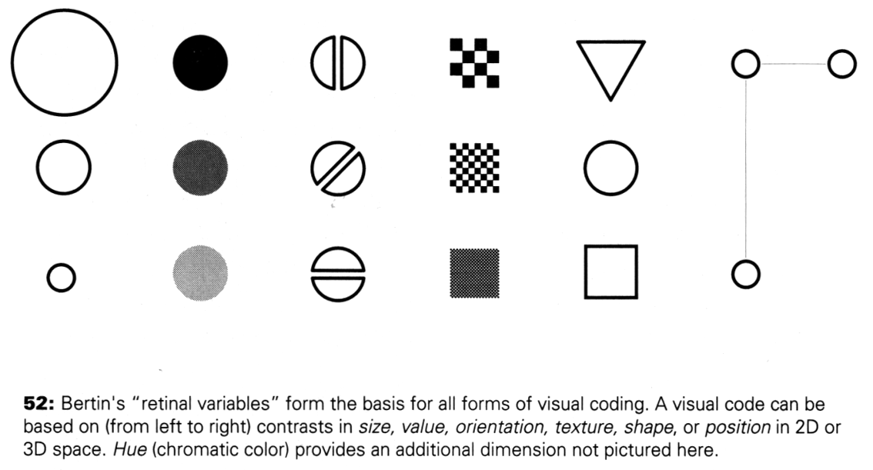
Making Things Distinct
Size
Value
Orientation
Texture
Shape
Position (2D / 3D)
Kevin Mullet and Darrell Sano, Designing Visual Interfaces
Slide from Marti Hearst/Jeff Heer via Jason Hong
Notes:
Note that while size and other cues provide for quantitative comparison, color (even luminance) only provides for ordering.
If the goal is contrast along any of these axes, make it distinct!

Slide 18
What can people easily decode?
Ranked Order:
Position along a common scale (e.g., scatterplot)
Position along identical but non-aligned scales (e.g., table of scatter plots)
Length (e.g., bar chart)
Then angle & slope (pie chart); area (bubbles); volume/density/color (heatmap) and hue
William S. Cleveland and Robert McGill (1984) Graphical Perception: Theory, Experimentation, and Application to the Development of Graphical Methods (J. Am. Statistical Association)

Slide 19
Putting it all together
Use the eye for pattern recognition: people are good at
Scanning
Recognizing
Remembering images
What they do depends on their “visual query”
Tends to be “just in time”
Key graphical elements
Length
Shape
Orientation
Texture
Animation shows changes across time
Color helps make distinctions
Aesthetics make the process appealing

Slide 20
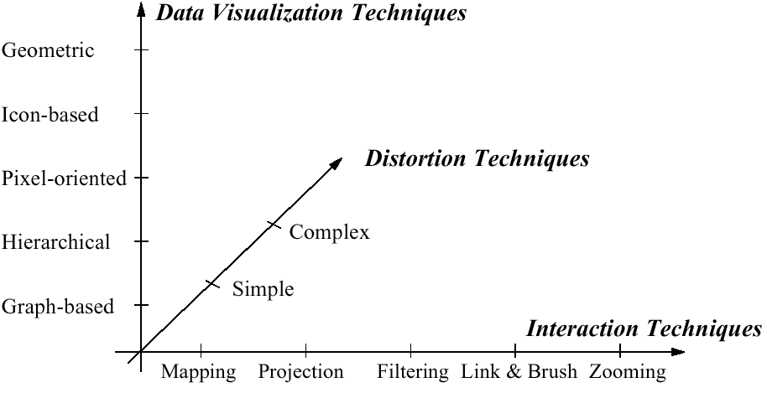
Visualization Techniques
http://www.visual-literacy.org/periodic_table/periodic_table.html
Notes:
nguyen

Slide 21
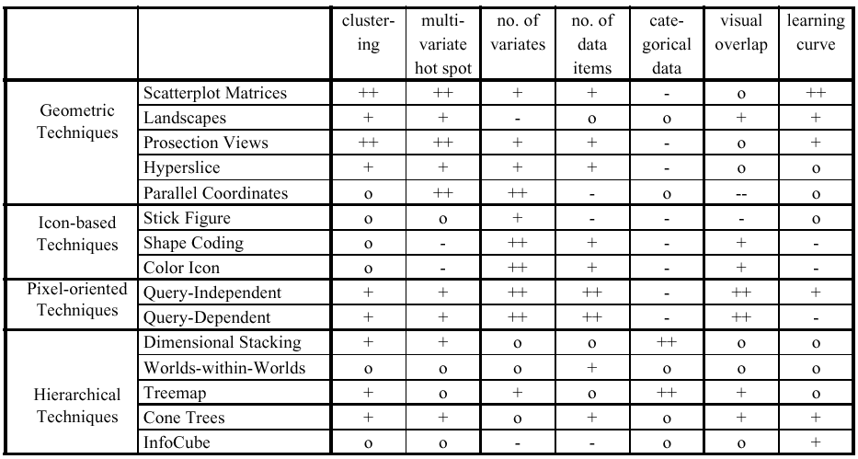
Comparison by Keim

Slide 22
Design Process
Define the visual query[ies] you wish to support
“The special skill of designers … [is] the talent to analyze a design in terms of its ability to support the visual queries of others…”
Patterns ⬄ visual system
Cognitive process prediction
A continual fresh eye

Slide 23
Holistic Design Goals for Information Visualization
Tailor to the application and the domain
Create highly interactive and integrated systems
Embed the visualization within a larger application
Provide alternative views

Slide 24
Heer & Shneiderman: Interactive Dynamics for Visual Analysis
Data & View Specifications | Visualize (choose encoding) Filter (focus on relevant items) Sort (expose patterns) Derive values or models
View Manipulation | Select (to highlight, filter, or manipulate) Navigate (zoom to examine patterns & detail) Coordinate (linked exploration) Organize windows and workspaces.
Process & Provenance | Record analysis histories Annotate patterns to document findings. Share views and annotations Guide users through analysis tasks or stories.
ACM QUEUE, Feb 20, 2012

Slide 25
Heer & Shneiderman: Interactive Dynamics for Visual Analysis
Data & View Specifications | Visualize (choose encoding) Filter (focus on relevant items) Sort (expose patterns) Derive values or models
View Manipulation | Select (to highlight, filter, or manipulate) Navigate (zoom to examine patterns & detail) Coordinate (linked exploration) Organize windows and workspaces.
Process & Provenance | Record analysis histories Annotate patterns to document findings. Share views and annotations Guide users through analysis tasks or stories.
ACM QUEUE, Feb 20, 2012

Slide 26
Key Questions to Ask About a Visualization
What does it teach/show/elucidate?
What are some compelling, useful examples? [COPY COPY COPY!]
Could it have been done more simply?
Have there been usability studies done? What do they show?

Slide 27
Does visualization help?
The jury is still out
Still supplemental at best for text collections
A correlation with spatial ability
Learning effects: with practice ability on visual display begins to equal that of text

Slide 28
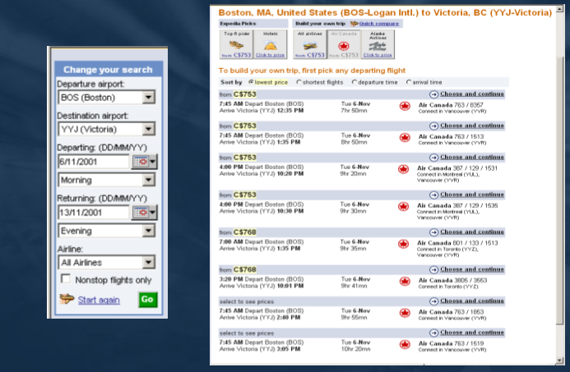
Create Your Own

Slide 29
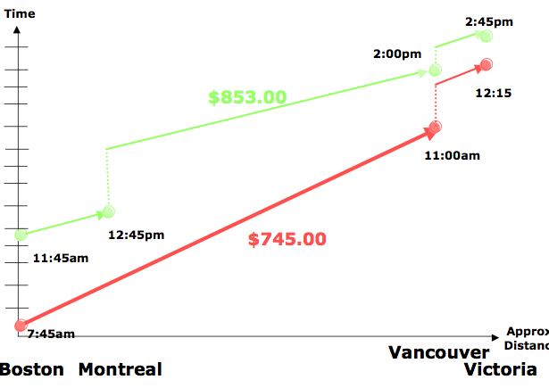
Create Your Own

Slide 30
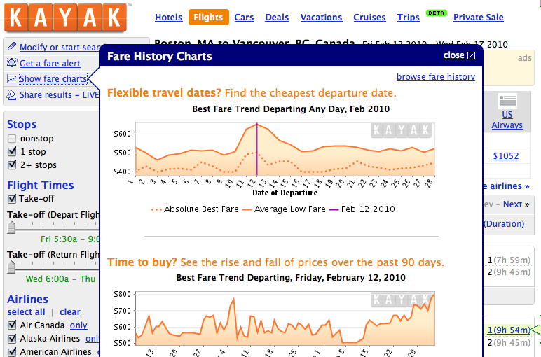
Create Your Own
Notes:
Lightweight Visualization

Slide 31
Other relevant topics if this area interests you…
Scientific visualization
Statistics
Cartography (maps)
Education
Games
Computer graphics in general
Computational geometry

Slide 32
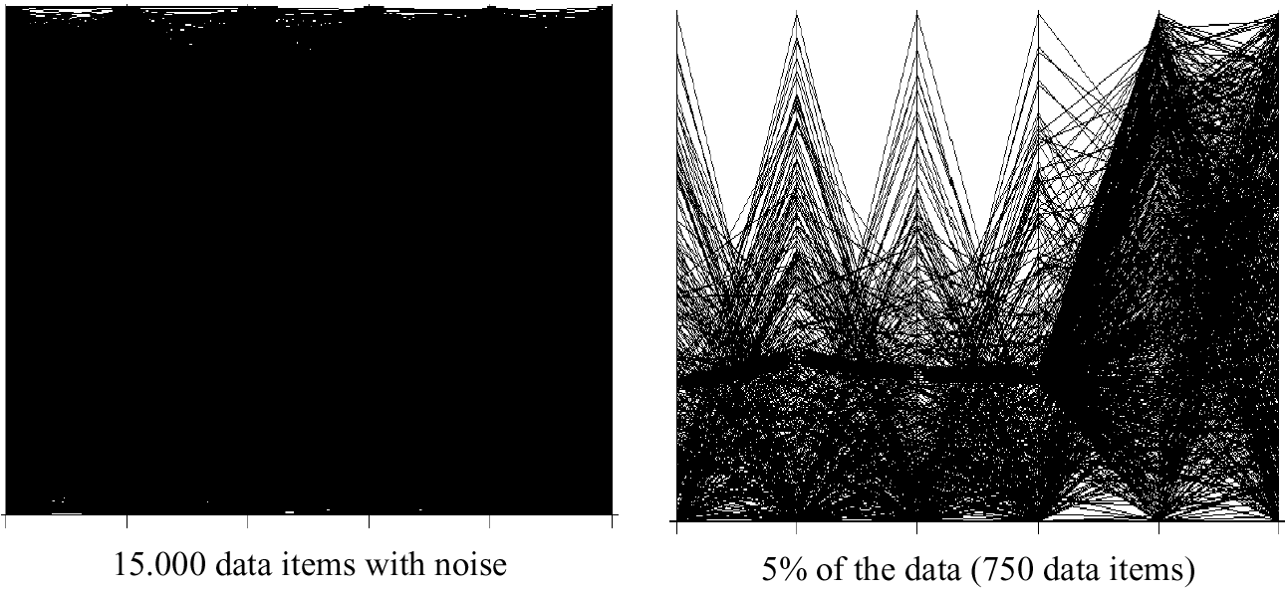
Visualization Techniques for Big Data

Slide 33
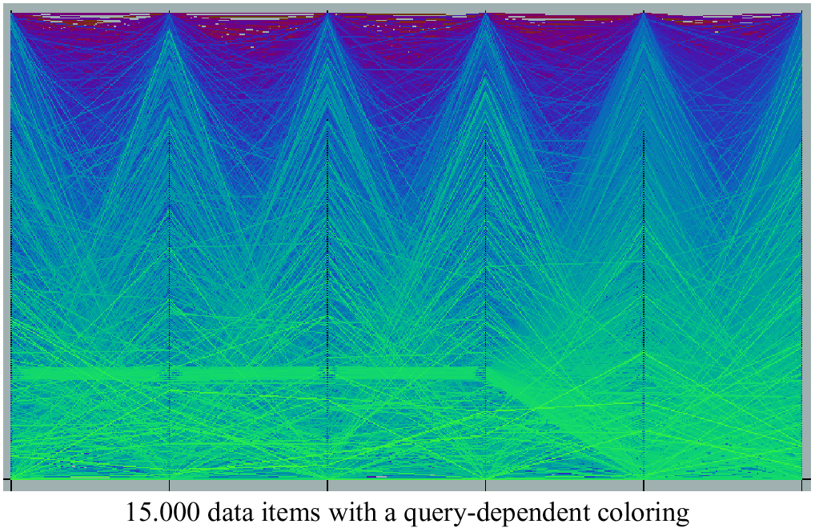
Query Dependent Coloring

Slide 34
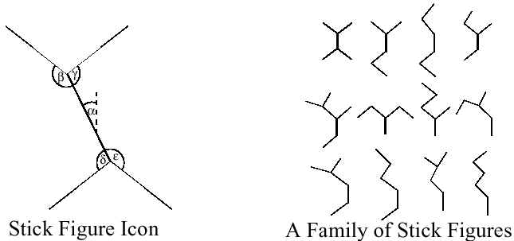
Stick Figures
Notes:
Visualization of the multidimensional data using stick figure icons
Two attributes of the data are mapped to the display axes and the remaining at-tributes are mapped to the angle and/or length of the limbs
Texture patterns in the visualization show certain data characteristics

Slide 35
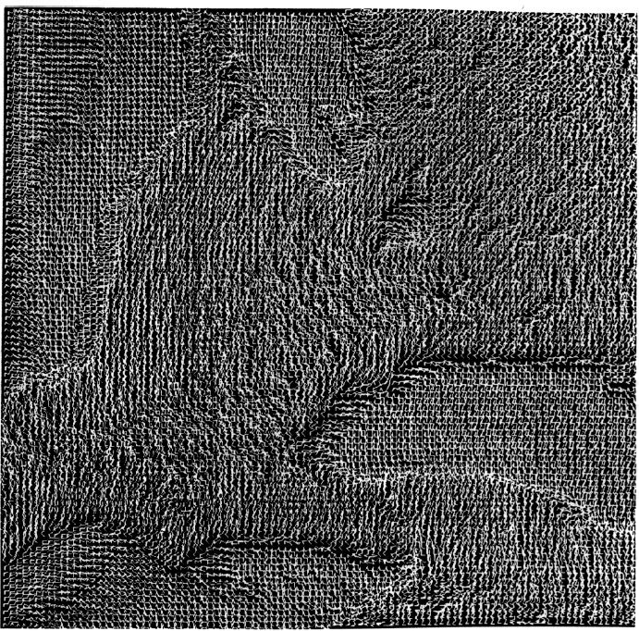
Stick Figures

Slide 36
Distortion Techniques
Basic Idea: Distortion of the image to allow a visualization of larger amounts of data
Simple:
Perspective Wall [MRC91]
Bifocal Displays [SA 82]
TableLens [RC94]
Graph. Fisheye Views [Fur 86, SB94]
Hyperbolic Repr. [LR94, LRP95]
Complex:
Hyperbolic Repr. [LR94, LRP95]
3D-Hyperbolic Repr. [MB95]
Hyperbox [AC91]

Slide 37
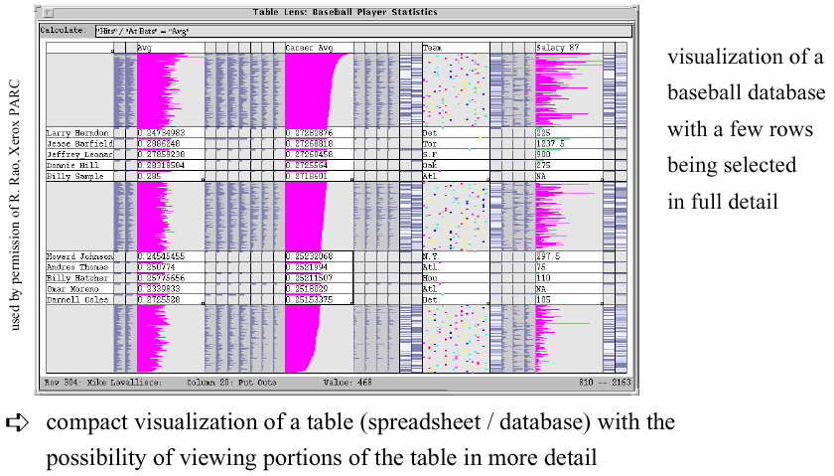
Table Lens

Slide 38
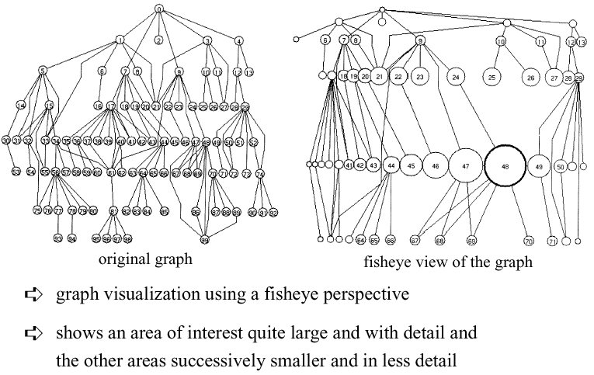
Fisheye View

